Slide 1



IBM NALAYATHIRAN PROJECT
DOMAIN: ARTIFICIAL INTELLIGENCE
PROJECT TITLE:AI BASED DISCOURSE FOR BANKING INDUSTRY

Slide 2
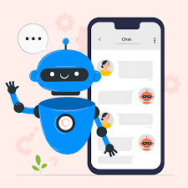
TEAM DETAILS
Team ID: PN2022TMID51074
Team Members:
Indhumathi C
Dharshini P
Jeyagomathi S
Kaviya S

Slide 3
Project
Description
In this project, we will be building a chatbot using Watson's assistant. This chat should have the following capabilities:
The Bot should be able to guide a customer to create a bank account.
The Bot should be able to answer loan queries.
The Bot should be able to answer general banking queries.

Slide 4

Problem Statement
This Project aims to create a Watson Assistant chat bot for banks where users/customers can ask any bank –related questions such as loans services account creation and so on. Even if the user doesn’t use proper sentence structure, it will understand the query and answer.

Slide 5

Proposed solution
Create a banking account, loan queries, Net banking and also general queries related to bank services for customers
Can communicate easily with the banking industry
Customer engagement is the critical requirement to boost the sales in business and keep customers engaged

Slide 6
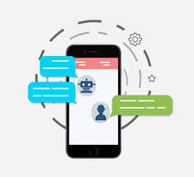
Future Scope
In future we can push notifications
directly to the user.
In future we can able to provide
location based answers to the clients.
It can able to review and customize
Accounts directly.
In future we will be able to answer to queries
in user’s region-specific languages.
Communication with audio support will allow
user to access chat bot easily.

Slide 7
THANK YOU!!!

